Slide 1
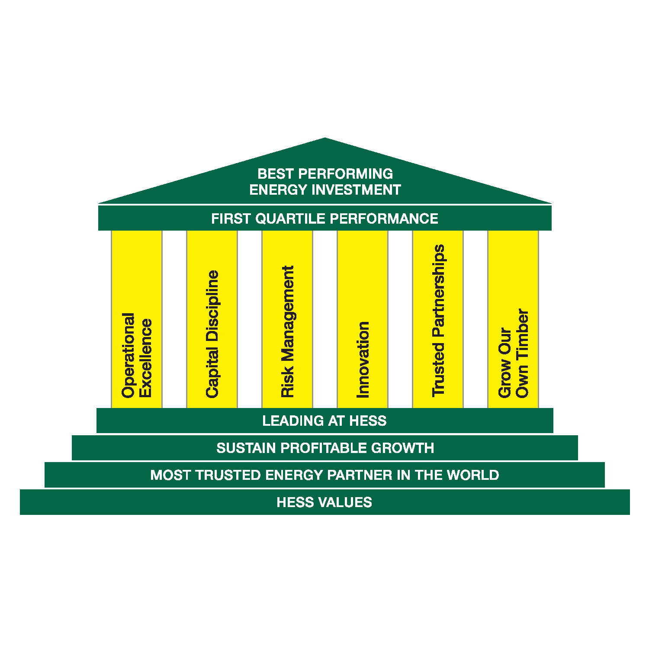
2013 Board of Directors Compensation Quick Reference
PEER GROUP
ANADARKO E&P APACHE E&P BP Integrated CHEVRON Integrated CONOCOPHILLIPS Integrated DEVON ENERGY E&P EOG RESOURCES E&P EXXONMOBIL Integrated MARATHON E&P MURPHY Integrated OCCIDENTAL Integrated ROYAL DUTCH SHELL Integrated STATOIL Integrated TALISMAN ENERGY Integrated TOTAL Integrated
OFFICER CRITERIA
President, principal financial officer, principal accounting officer or any vice president in charge of a principal business unit, division or function Any other officer who performs a policy making function or any other person who performs similar policy making functions SEC’s definition of “officer” is rather broad which allows for company interpretation: This judgment factor is reflected in the wide range of practice among our own peer group Nine positions designated as executive officers by Hess Board of Directors: 1. CHAIRMAN AND CEO 2. EVP & PRESIDENT, E&P 3. EVP & PRESIDENT, M&R 4. SVP AND CFO 5. SVP AND GENERAL COUNSEL
6. SVP, FINANCE AND CORPORATE DEVELOPMENT
7. SVP, M&R SUPPLY AND FINANCIAL CONTROLS
8. SVP, HUMAN RESOURCES
9. VP & TREASURER
ORGANIZATIONAL LEVELS/SALARY BANDS
10 | Chief Executive Officer | 9 | President, Executive Vice President | 8 | Senior Vice President | 7 | Vice President | 6 | Professional Staff and below

Slide 2
Compensation Governance Principles
WHAT WE STRIVE FOR
Pay for Performance | Significant portion of executive officer compensation is linked to corporate and stock performance | New PSU program further strengthens this pay and performance linkage
Mitigate Compensation Risk | Plans have capped upside potential | Recoupment policy in place
Retain, Attract & Motivate Key Talent | Program designed to attract, motivate talented executives who can help achieve superior financial results | Stock plan promotes retention
Stringent Stock Ownership Requirements | CEO: 6x base salary EVP: 4x base salary | SVP: 3x base salary VP: 1x base salary
Align Executive Interests with Stockholders | Long-term compensation is in form of equity | Restricted stock awards contingent upon meeting cash flow requirements and PSUs contingent upon relative TSR results
Emphasize Culture of Safety and Sustainability | Compensation programs aligned to safety and sustainability commitment
 |  | (more)

Slide 3
Compensation Governance Principles (Continued)
WHAT WE STRIVE FOR
Significant Portion of Executive Pay at Risk | New PSU program is measured by relative TSR over a three-year period
Review Stock Utilization Annually | Utilization and dilution measured annually to inform program design and award levels
Limited Perquisites and Consistent Benefit Programs | Perquisites or personal benefits capped at $10,000 annually
WHAT WE PROHIBIT
EMPLOYMENT CONTRACT FOR CEO
STOCK OPTION REPRICING
HEDGING ON AWARDED HESS STOCK
DIVIDENDS OR DIVIDEND EQUIVALENTS ON UNEARNED PSUs OR RESTRICTED STOCK

Slide 4
“Top 5” Compensation
(Proxy statement disclosure)
 | YEAR | SALARY | BONUS | STOCK | OPTIONS | NON-EQWUITY INCENTIVE | CHANGE IN PENSION VALUE & NON-QUALIFIED DEFERRED COMP EANRNINGS | ALL OTHER COMP | TOTAL
John B. Hess Chairman & CEO | 2012 2011 | 1,500,000 1,500,000 | - 1,307,583 | 8,514,673 4,219,584 | - 4,280,375 | - 1,942,417 | 3,106,643 4,210,185 | 19,950 14,700 | 13,141,266 17,474,844
Greg Hill EVP & President Worldwide E&P | 2012 2011 | 975,000 940,000 | - 373,883 | 3,506,131 1,737,526 | - 1,762,432 | 582,983 536,117 | 817,745 857,097 | 19,950 14,700 | 5,901,809 6,221,755
Borden Walker EVP & President, M&R | 2012 2011 | 950,000 935,000 | - 230,200 | 2,504,340 1,241,452 | - 1,258,759 | 490,933 584,800 | 1,377,597 1,723,973 | 19,950 14,700 | 5,342,820 5,988,884
Timothy Goodell SVP & General Counsel | 2012 2011 | 725,000 700,000 | - 281,633 | 2,003,444 992,993 | - 1,006,922 | 429,567 418,367 | 348,230 322,128 | 19,950 14,700 | 3,526,191 3,736,743
John P. Rielly SVP & CFO | 2012 2011 | 750,000 725,000 | - 126,167 | 2,003,444 992,993 | - 1,006,922 | 306,883 298,833 | 876,670 918,719 | 19,950 14,700 | 3,956,897 4,083,334

Slide 5
Pay Mix
Salary Actual Annual Incentive Cash Bonus Long-Term Incentive Equity Award
John Hess
Greg Hill
Borden Walker
Tim Goodell
John Reilly
PAY MIX
“Top 5” Compensation Pay for Performance jCEO: 6x base salary jEVP: 4x base salary jSVP: 3x base salary jVP: 1x base salary Salary Actual Annual Incentive Cash Bonus Long-Term Incentive Equity Award 15% 85% John Hess 24% 12% 64% 14% 23% 63% 10% 65% 25% John Rielly 12% 19% 69% Greg Hill 31% 25% 19% 14% 9% 2% Medical Vacation/Holiday Savings Plan Pension All Other Dental M A J O R B E N E F I T S * B E N E F I T A L L O C A T I O N W H A T W E S T R I V E F O R Medical & Pharmacy Dental Savings Pension Basic Life Insurance Optional Life Insurance Family Accident Insurance Long-Term Disability Insurance Sickness & Injury Pay Employee Assistance Program (EAP) Vacation Holidays Education Assistance Financial Planning Services E&P E&P Integrated Integrated Integrated E&P E&P Integrated E&P Integrated Integrated Integrated Integrated Integrated Integrated PEER GROUP President, Executive Vice President 10 9 8 7 6 Chief Executive Officer Vice President Senior Vice President Professional Staff and below O F F I C E R C R I T E R I A ORGANIZATIONAL LEVELS/SALARY BANDS ANADARKO APA C H E BP CHEVRON CONOCOPHILLIPS DEVON ENERGY EOG RESOURCES EXXONMOBIL MARAT H O N MURPHY OCCIDENTA L ROYAL DUTCH SHELL STAT O I L TALISMAN ENERGY TOTA L (Proxy statement disclosure)

Slide 6
Compensation Package
TOTAL PAY
Base Salary | Recognize value of historical Corporate performance and current responsibilities Recognize internal equity of comparable positions | Reflect external market value of job responsibilities and skills (attract/retain)
Merit Increase | Reward value of individual performance during prior year Recognize increase in market “cost of labor” (supply/ demand) for key skills | Does not reflect “cost of living” (inflation) for goods and services
Cash Bonus | Reward the achievement of annual individual, business and enterprise objectives | Provide opportunity for meaningful differentiation of individual performance
Long-Term Incentive | Reward the achievement of long-term individual and enterprise objectives Reflect the magnitude of position’s impact on company’s success | Provide opportunity for meaningful differentiation of individual potential and sustained performance Align employee and shareholder interests

Slide 7
Compensation Package
ANNUAL CASH BONUS PLAN
Corporate | 1/3 weighting Metrics include enterprise profitability | Formulaic payout range: 0 – 150%
Business Unit | 1/3 weighting Metrics include business profitability, cost control, safety, reserves, production, etc | Formulaic payout range: 0 – 150%
Individual | 1/3 weighting Metrics include objectives specific to each employee, agreed upon with manager | Payout range: 0 – 150%

Slide 8
Compensation Package
LONG TERM INCENTIVE
Award Philosophy | Provide LTI compensation that is competitive and consistent with market practices | Reward employees based on their own performance as well as that of the enterprise Ensure LTI program is transparent and well understood
Program Design | Awards require Board approval Timing – Annual awards granted in March Utilize 2 vehicles – restricted stock and performance share units (PSUs) | Manage share utilization within industry norms and institutional shareholder guidelines Differentiate awards based on sector (upstream versus downstream)
Award Levels and Participation | Differentiate individual awards by salary band, sustained and participation performance and leadership/technical potential
COMPONENTS
Performance Share Units (”PSUs”) | Hess Total Shareholder Return (“TSR”) rank relative to 15 company peer group over a 3-year performance period TSR is based on the 60-day average price at the beginning and end of the Period | Award will not payout more than 100% if Hess’ TSR is negative Provides dividend rights but are non-voting Valuation model generally results in PSU value being higher than restricted stock Value
Restricted Stock | Shares of company stock that must be held for a minimum length of time (vesting period) | Provides voting and dividend rights Vesting: 3-year “cliff” vesting

Slide 9
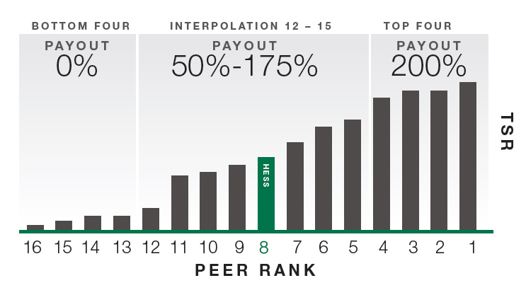
Compensation Package
PERFORMANCE SHARE UNITS (PSUs)
RANK | PAYOUT
1 | 200%
2 | 200%
3 | 200%
4 | 200%
5 | 175%
6 | 150%
7 | 125%
8 | 100%
9 | 88%
10 | 75%
11 | 63%
12 | 50%
13 | 0%
14 | 0%
15 | 0%
16 | 0%
Relative Total Shareholder Return (TSR) will be calculated over the 3-year performance period. Hess’ payout as % of target will depend on its TSR ranking
In the illustration below, Hess is shown ranked 8 of the 15 peers:
– Rank 1 through 4: 200% of the targeted number of shares will be awarded
– Rank 5 though 12: payouts will be interpolated and range from 50% to 175%
– Rank 13 through 16: no shares will be awarded
– If TSR is negative: payout is capped at 100%

Slide 10
Benefits Package
MAJOR BENEFITS*
BENEFIT ALLOCATION
Medical & Pharmacy
Dental
Savings
Pension
Basic Life Insurance
Optional Life Insurance
Family Accident Insurance
Long-Term Disability Insurance
Sickness & Injury Pay
Employee Assistance Program (EAP)
Vacation
Holidays
Education Assistance
Financial Planning Services *Full-time, non-Retail in the U.S.
Medical
Vacation/Holiday
Savings Plan
Pension
All Other
Dental

Slide 11
Headcount Snapshot* as of March 31, 2013
EXECUTIVES
E&P | 25
M&R | 18
Corporate Functional Group Includes Top 5 | 44
TOTAL | 87
BUSINESS UNIT
E&P | 2,527
M&R | 9,150
Corporate Functional Group Includes Top 5 Hovensa, HETCO | 1,383 220
TOTAL | 13,280
UNITED STATES
New York | 310
Woodbridge | 654
Houston | 1,295
Pt. Reading/Terminals/St Lucia | 484
E&P Field & Other US | 888
Retail Field | 8,058
TOTAL | 11,689
INTERNATIONAL
Europe | 423
Africa | 260
Asia Pacific | 685
Brazil | 3
TOTAL | 1,371
Hovensa | 125
HETCO | 95
TOTAL | 220
TOTAL U.S. AND INTERNATIONAL (HESS, HETCO AND HOVENSA) 13,280
*Excludes all contractors, fixed term workers and interns. US total includes Hess employees only.

