Slide 1
PRESENTATION TITLE HERE
SUPPORT LINE GOES HERE

Slide 2
SECTION TITLE HERE
SUPPORT LINE GOES HERE

Slide 3
SECTION TITLE HERE
SUPPORT LINE GOES HERE

Slide 4
SECTION TITLE HERE
SUPPORT LINE GOES HERE

Slide 5
SECTION TITLE HERE
SUPPORT LINE GOES HERE

Slide 6
President Award for Safety Excellence
2012

Slide 7
The North Dakota Wells Base Team
0
Recordable
Injuries
490 days, 16 rigs,
crew experience 3 years avg.

Slide 8
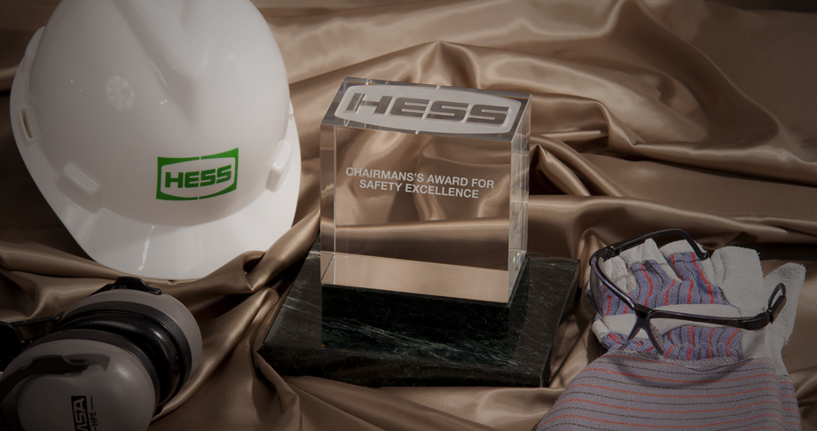
CEO Award for Safety Excellence
2012

Slide 9
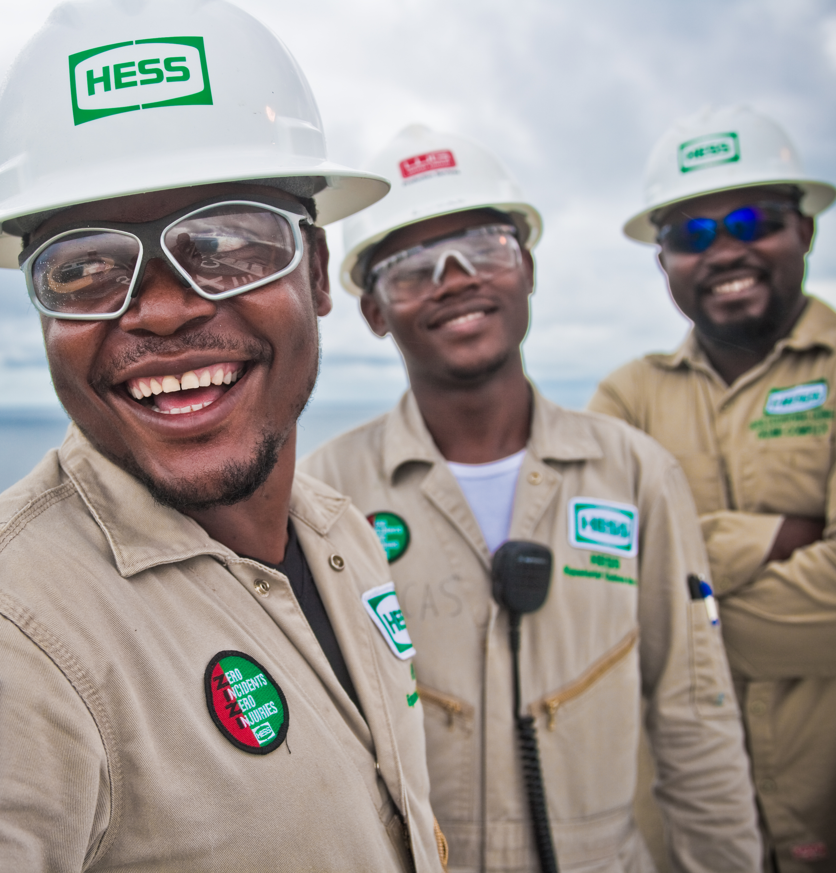
The Okume Team: Equatorial Guinea
0
Recordable
Injuries
More than 5 Years and
1.7 million man-hours worked!

