Slide 1
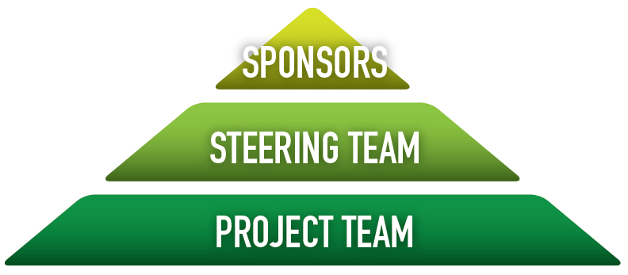
Steering Team
Roles and Responsibilities, Organization, and Operating Rhythm
Roles & Responsibilities
Expectations
Operating Rhythm
Communicate applicable aspects of this project through their organizations.
Provide endorsement for the final outputs prior to approval from the project sponsors.
Approve changes to scope categorized as low.
Reject or endorse medium or high changes to the Sponsors.
Attend Steering Team meetings whenever possible.
Be an active participant during discussions.
Communicate to your stakeholders.
Dedicate resources to applicable deliverables and action items.
Meet monthly for 30 minutes after PLT meeting.

Slide 2
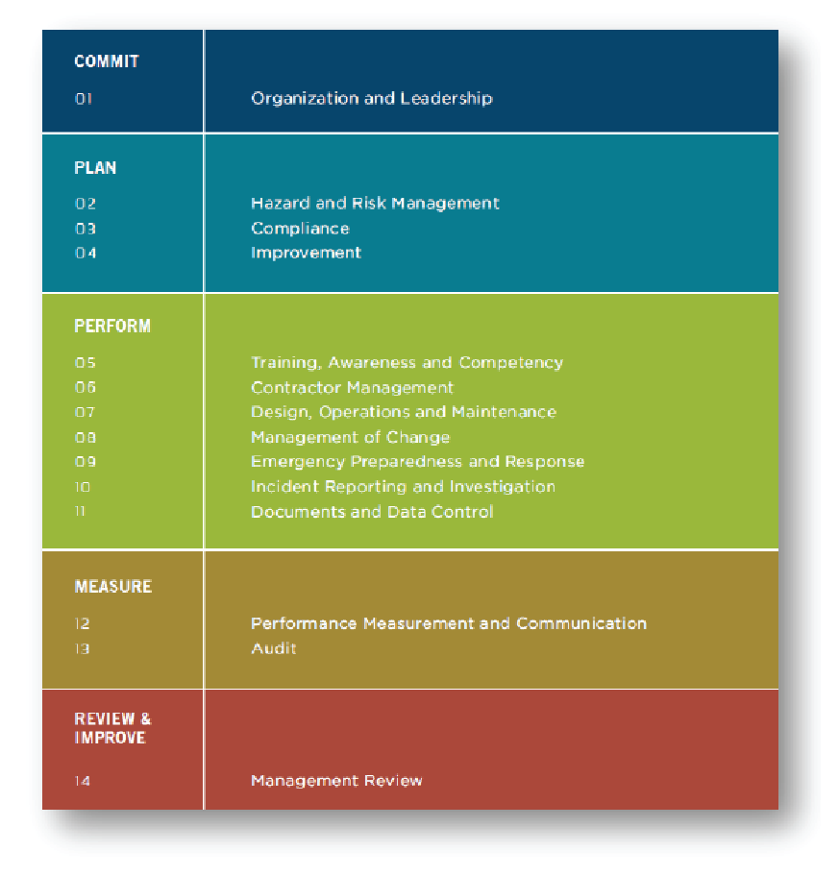
Project Scope
Application of HOMS
Applies to all operational activities
Adheres to the 14 elements of the EHS Management System.
A user-friendly document interface will be developed that illustrates document relationships/ hierarchy and compliance.

