Slide 1


Slide 2




Safety Moment
Alarms
Exits
Stairs
Muster Point

Slide 3
Welcome
2019 Global Safety Appreciation Day
Today’s Objectives:
Celebrate 11 Years of ‘Global Safety Appreciation Days’
Reaffirm Our Safety Goal is Zero incidents
Discuss Our Performance
Show how Lean and Safety Work Together
Discuss actions we can take to drive continuous improvement

Slide 4

A Message from Greg

Slide 5
Why Rules
The Hess Rules
Severe incident reduction was identified as a key focus item by Hess
Senior Management. Statistical analysis has indicated certain high-risk activities contributed to a majority of our severe incidents.
To help mitigate these severe incidents, the Hess Rules have been developed to:
Set expectations around high risk activities,
Provide a platform to discuss the risks associated with these activities,
Provide a simple resource to improve safe behaviors,
Describe basic global requirements for (but not replace) local safe work practices,
Give all employees the ability to spot unsafe behaviors associated with those
activities, and
Ensure appropriate consequences are applied when poor behavior occurs.

Slide 6
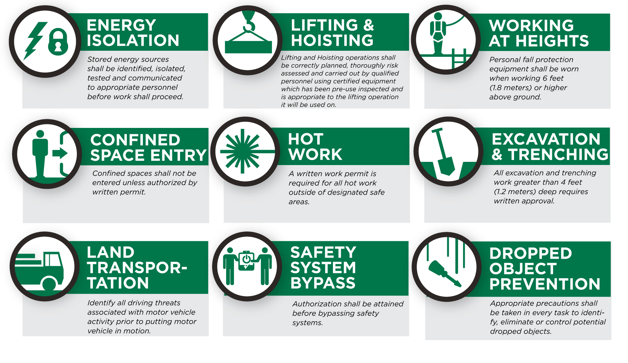

The Hess Rules
9 Rules Redefined

Slide 7

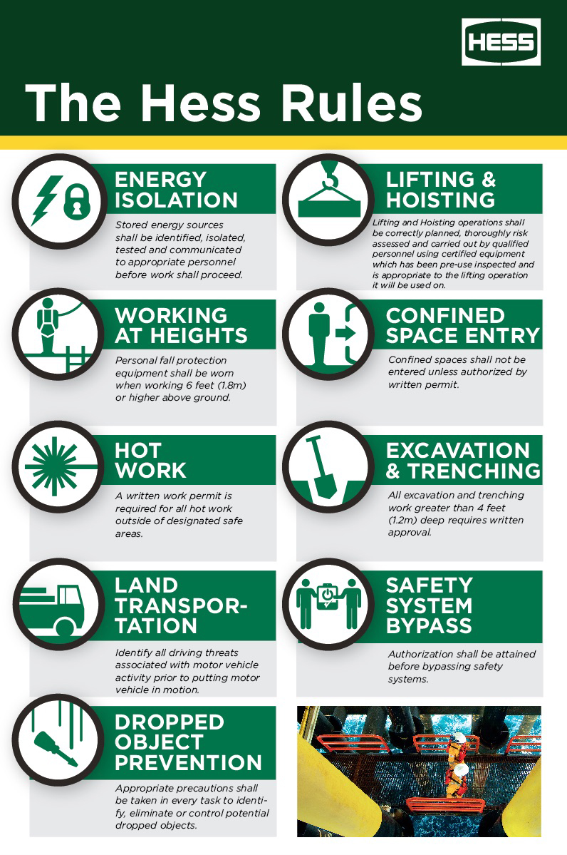
Updated Rules Poster and Brochure

Slide 8
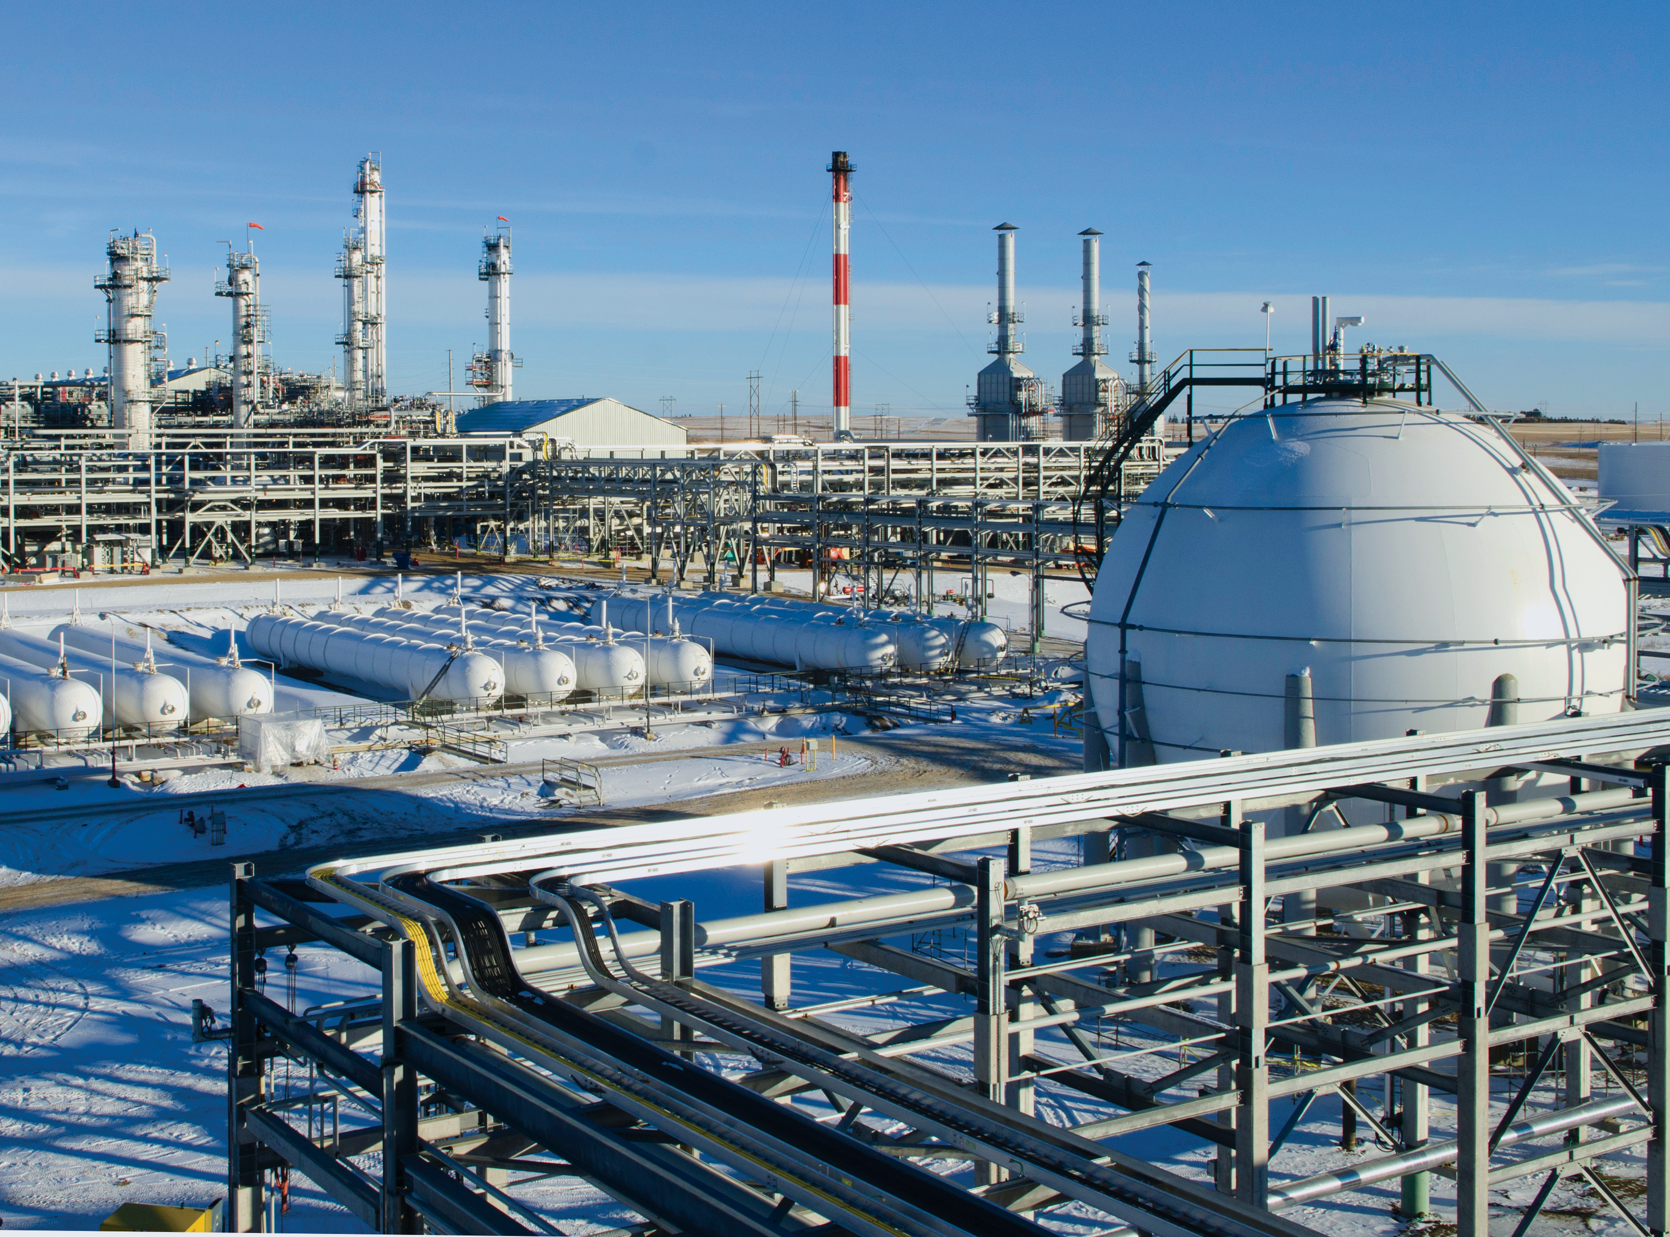
Our Goal is Zero Incidents
It starts with Occupational safety and Process
OCCUPATIONAL SAFETY
Preventing injuries and illnesses to ourselves and coworkers.
• Largely controlled through workforce behaviors
• Performing Job Safety Analysis, Drops prevention, following Hess Rules & safety procedures, etc.
PROCESS SAFETY
LOPC incidents, which can escalate to Major Accident Events.
Keep it in the Pipes!.
• Largely controlled by equipment design, 33 operations and maintenance practices
• Design Standards, operating procedures, safety critical equipment maintenance, etc.

Slide 9
With data and topic discussion
Customizable section for assets

Slide 10




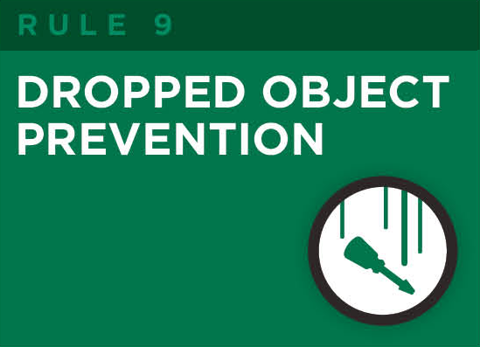
Key areas of focus for ASSET NAME
Pick up specific rules for asset from slide #00

Slide 11
Summary/Conclusion

Slide 12
Next Steps

Slide 13

South Arne

Slide 14
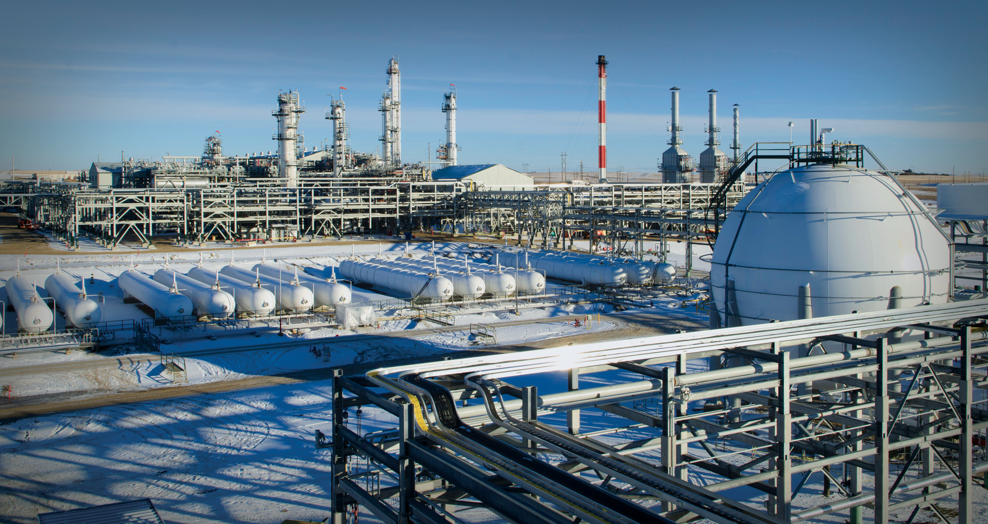
Bakken

Slide 15

Baldpate

Slide 16

JDA

Slide 17

JDA

Slide 18
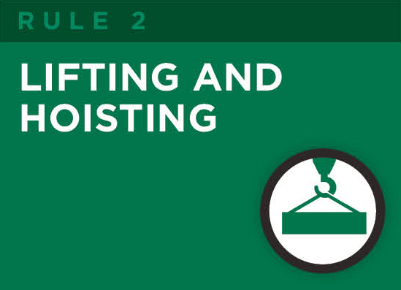


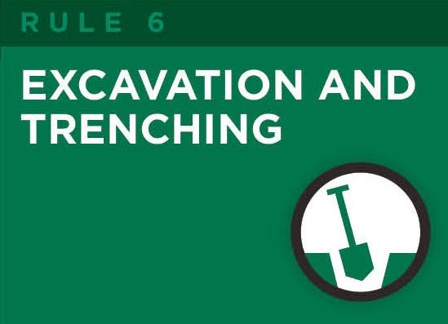

Pick up rule for your asset and place on slide #00

