Slide 1
November 2020
South Arne

Slide 2
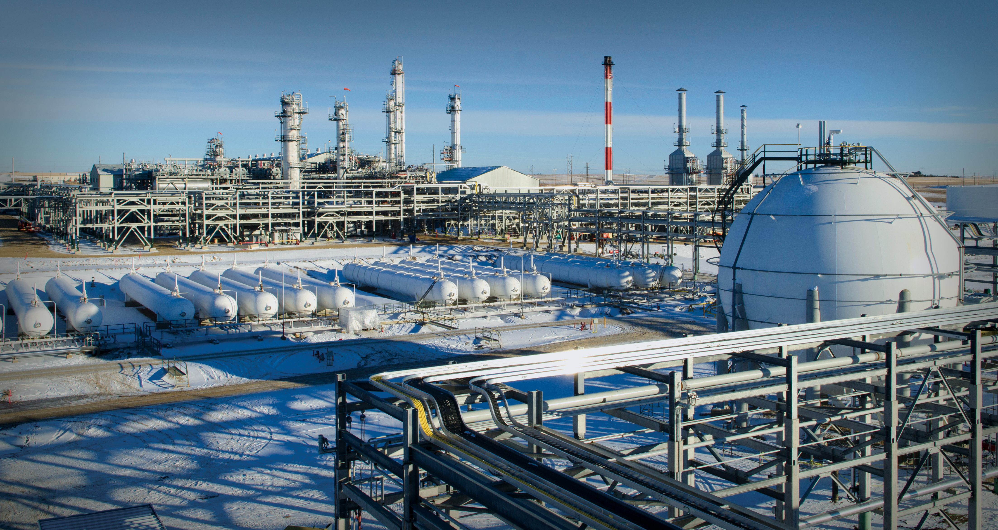
November 2020
Bakken

Slide 3
November 2020
Baldpate

Slide 4
November 2020
JDA

Slide 5
November 2020
JDA

