Slide 1
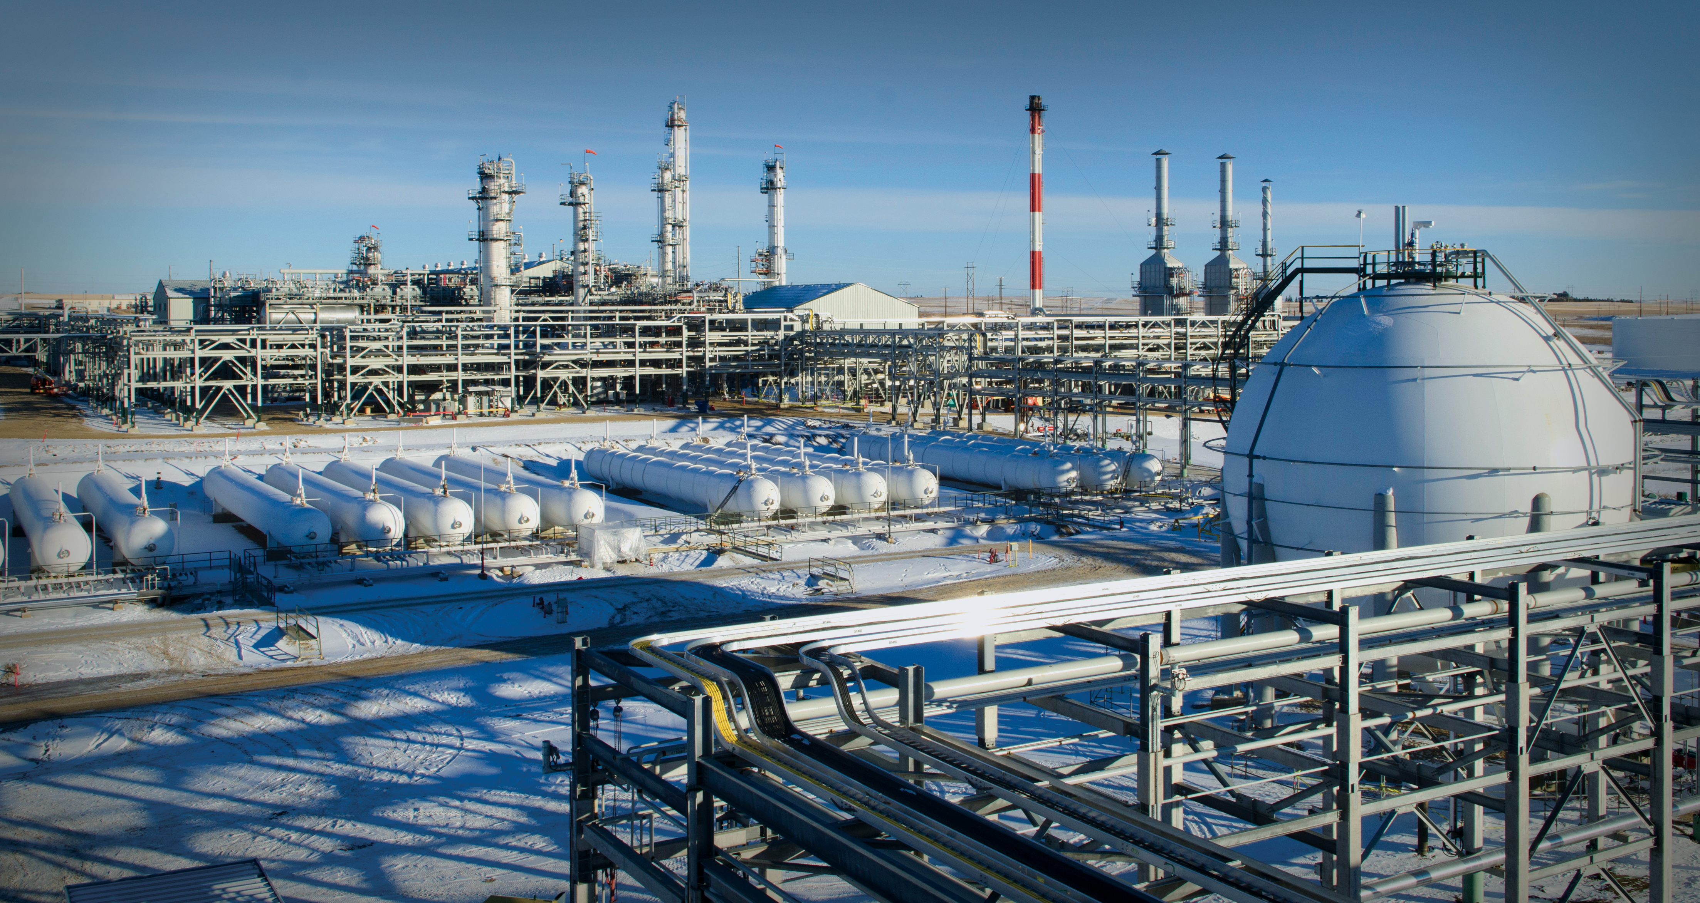
November 2021

Slide 2
November 2021

Slide 3
November 2021

Slide 4
November 2021

Slide 5
November 2021

Slide 6
November 2021

Slide 7
Safety Moment
Alarms
Exits
Stairs
Muster Point

