Slide 1
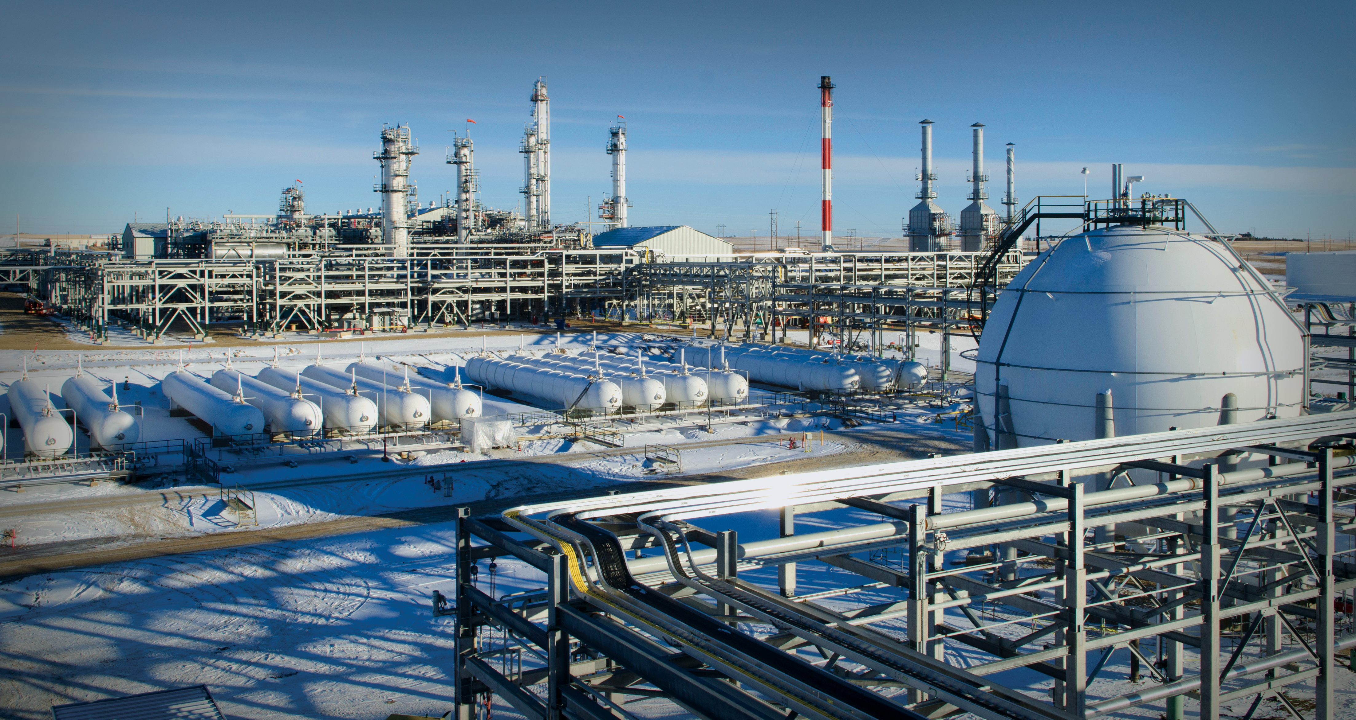
November 2022

Slide 2
November 2022

Slide 3
November 2022

Slide 4
November 2022

Slide 5
November 2022

Slide 6
November 2022

Slide 7
Safety Moment
Alarms
Exits
Stairs
Muster Point

